Slide 1
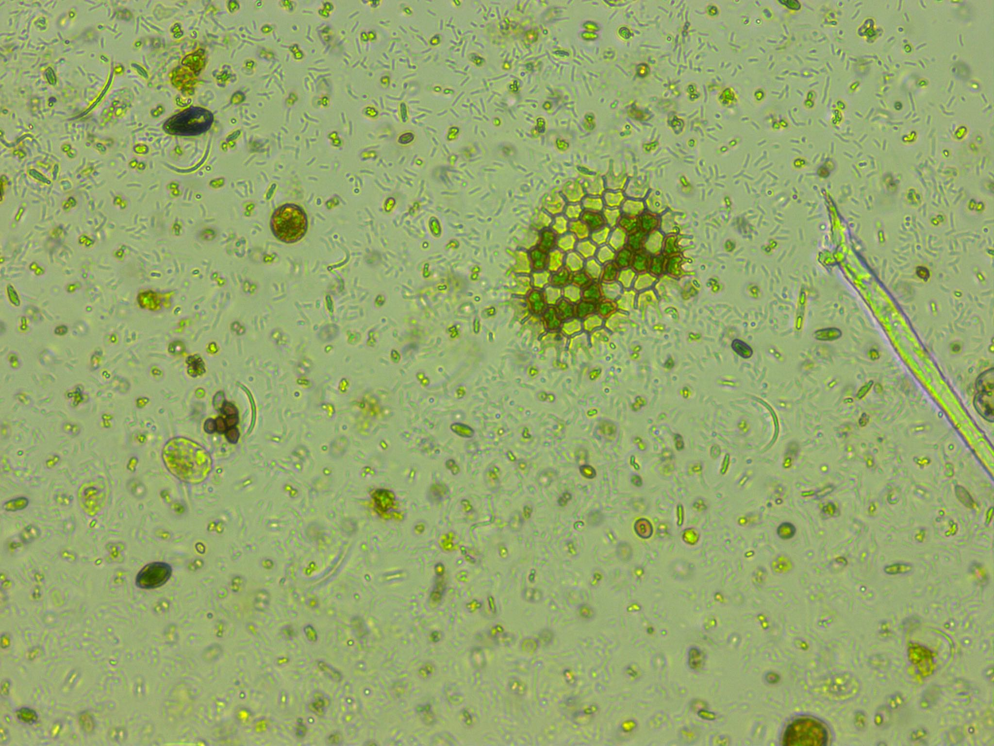
Predicting phytoplankton metabolism from the individual size distribution
Daniel Padfield

Slide 2
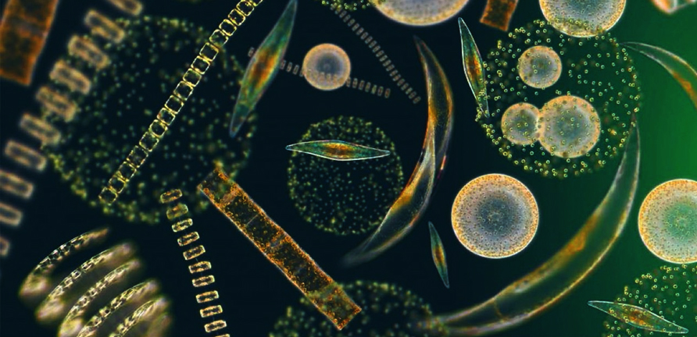
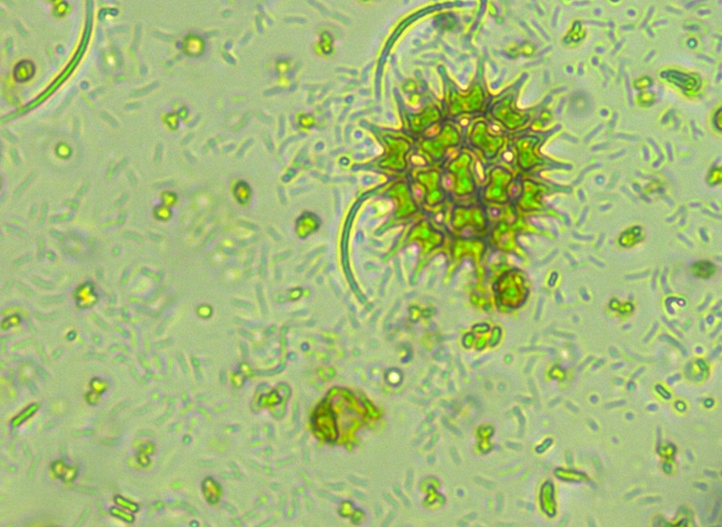
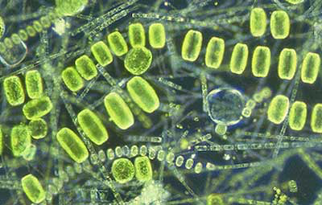
Phytoplankton are key for the carbon cycle
~50% of annual carbon fixation
Fuel entire ocean food webs

Slide 3
Current measurements of metabolism

Slide 4
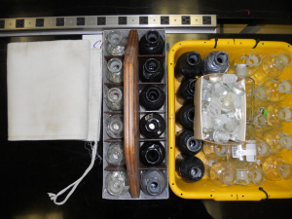
Current measurements of metabolism
Bottle incubations – in vivo
Snapshot in time
Single community
Control over environmental variables

Slide 5
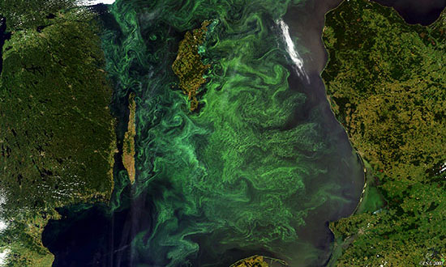
Current measurements of metabolism
Bottle incubations – in vivo
Gas measurements – in situ
Snapshot in time
Single community
Control over environmental variables
Integrates over large areas
Many communities and many different environmental conditions

Slide 6

Current measurements of metabolism
Bottle incubations – in vivo
Gas measurements – in situ
Total photosynthesis < total respiration
Total photosynthesis > total respiration

Slide 7

Crash course in metabolic theory

Slide 8

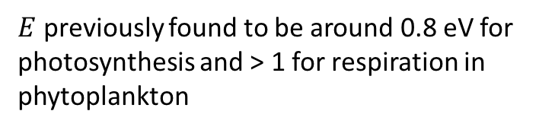
Crash course in metabolic theory
$$e^{\left.E(\frac{1}{kT_{c}}−\frac{1}{kT}\right)}$$
$E$ previously found to be around 0.8 eV for photosynthesis and > 1 for respiration in phytoplankton
🔥🔥🔥🔥🔥🔥🔥

Slide 9
Crash course in metabolic theory

Slide 10

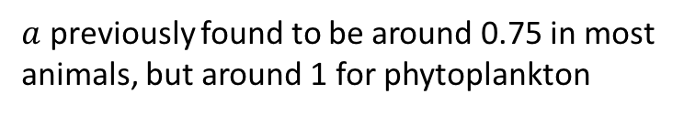
Crash course in metabolic theory
$$m_{i}^{a}$$
$a$ previously found to be around 0.75 in most animals, but around 1 for phytoplankton

Slide 11
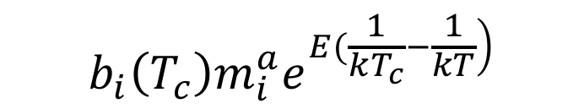
Crash course in metabolic theory
$$b_{i}\left(T_{c}\right)m_{i}^{a}e^{\left.E(\frac{1}{kT_{c}}−\frac{1}{kT}\right)}$$
🔥🔥🔥🔥🔥🔥🔥
🔥🔥🔥🔥🔥🔥🔥

Slide 12
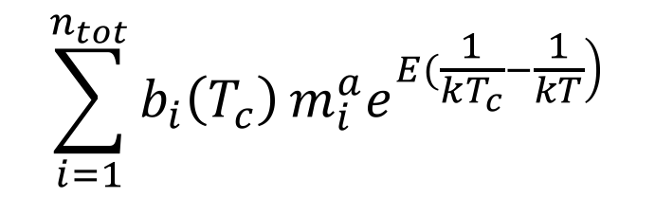
Crash course in metabolic theory
$$\sum_{i=1}^{n_{tot}}{b_{i}\left(T_{c}\right)}m_{i}^{a}e^{\left.E(\frac{1}{kT_{c}}−\frac{1}{kT}\right)}$$

Slide 13
Crash course in metabolic theory
$$\sum_{i=1}^{n_{tot}}{b_{i}\left(T_{c}\right)}m_{i}^{a}e^{\left.E(\frac{1}{kT_{c}}−\frac{1}{kT}\right)}$$
🔥🔥🔥
🔥🔥🔥🔥🔥🔥🔥🔥🔥🔥🔥🔥🔥🔥

Slide 14
Zero-sum dynamics

Slide 15
Zero-sum dynamics
🔥🔥🔥
🔥🔥🔥
🔥🔥🔥
🔥🔥🔥
🔥🔥🔥
🔥🔥🔥
🔥🔥🔥
🔥🔥🔥
🔥🔥🔥
Average individual metabolic rate

Slide 16
Zero-sum dynamics
Average individual metabolic rate

Slide 17
Zero-sum dynamics
🔥🔥🔥
🔥🔥🔥
🔥🔥🔥
Average individual metabolic rate
Total
abundance

Slide 18
Predictions
Predict community metabolic rates from the size- and temperature-dependence of individuals in the size distribution
Across-communities, there will be a trade off between total abundance and average individual metabolic rate
Trade offs between community properties may impact community flux

Slide 19
Experimental setup
10 years warming : half 4ºC above ambient

Slide 20

Experimental setup
How do the communities and their functioning change in response to long-term and short-term warming
10 years warming : half 4ºC above ambient
Cool incubator ~ 4 weeks
Warm incubator ~ 4 weeks

Slide 21
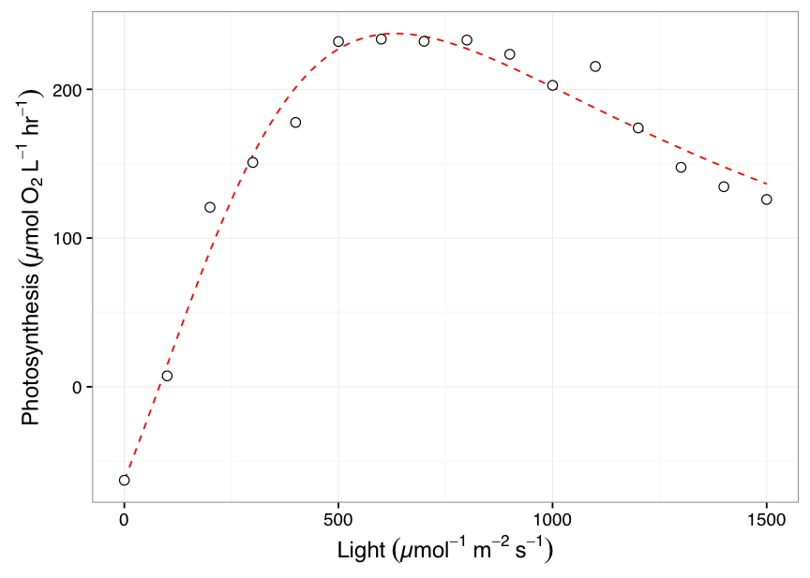
Measurements
+
Metabolism @ incubator temperature
1 point for each microcosm
Size distribution
> 300 points per sample!

Slide 22
Long-term warming changes communities

Slide 23
No difference in measured raw metabolism

Slide 24
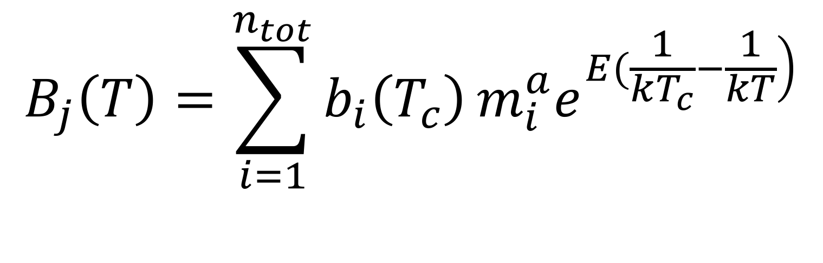
Model
$$B_{j}\left(T\right)=\sum_{i=1}^{n_{tot}}{b_{i}\left(T_{c}\right)}m_{i}^{a}e^{\left.E(\frac{1}{kT_{c}}−\frac{1}{kT}\right)}$$

Slide 25
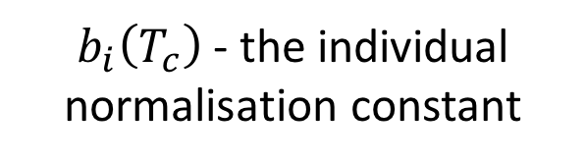
Model
$$B_{j}\left(T\right)=\sum_{i=1}^{n_{tot}}{b_{i}\left(T_{c}\right)}m_{i}^{a}e^{\left.E(\frac{1}{kT_{c}}−\frac{1}{kT}\right)}$$
$b_{i}\left(T_{c}\right)$ - the individual normalisation constant

Slide 26
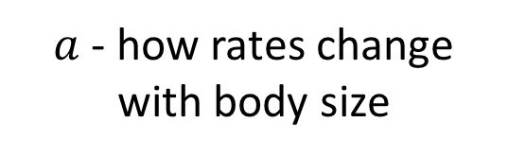
Model
$a$ - how rates change with body size
$$B_{j}\left(T\right)=\sum_{i=1}^{n_{tot}}{b_{i}\left(T_{c}\right)}m_{i}^{a}e^{\left.E(\frac{1}{kT_{c}}−\frac{1}{kT}\right)}$$

Slide 27
Model
$$B_{j}\left(T\right)=\sum_{i=1}^{n_{tot}}{b_{i}\left(T_{c}\right)}m_{i}^{a}e^{\left.E(\frac{1}{kT_{c}}−\frac{1}{kT}\right)}$$

Slide 28
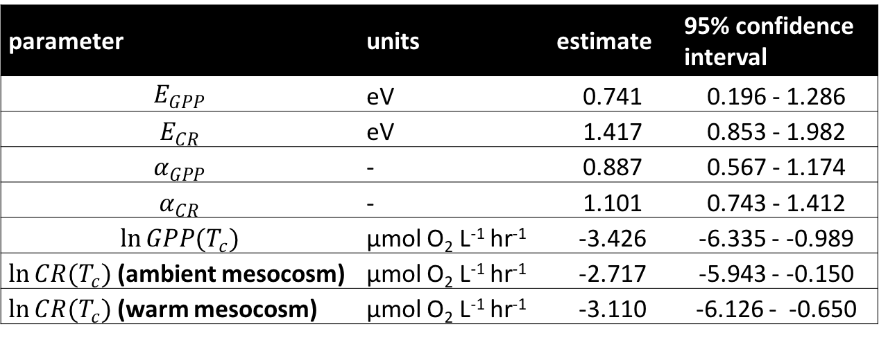
Model predicts size and temperature-dependence
parameter | units | estimate | 95% confidence interval
$$E_{GPP}$$ | eV | 0.741 | 0.196 - 1.286
$$E_{CR}$$ | eV | 1.417 | 0.853 - 1.982
$$α_{GPP}$$ | - | 0.887 | 0.567 - 1.174
$$α_{CR}$$ | - | 1.101 | 0.743 - 1.412
$$\ln{GPP(T_{c})}$$ | µmol O₂ L⁻¹ hr⁻¹ | -3.426 | -6.335 - -0.989
$\ln{CR(T_{c})}$ (ambient mesocosm) | µmol O₂ L⁻¹ hr⁻¹ | -2.717 | -5.943 - -0.150
$\ln{CR(T_{c})}$ (warm mesocosm) | µmol O₂ L⁻¹ hr⁻¹ | -3.110 | -6.126 - -0.650

Slide 29
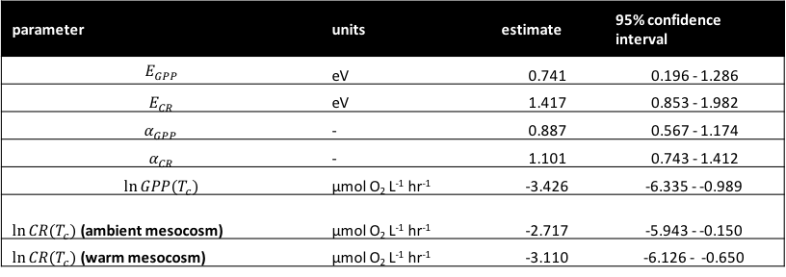
Predicted vs Observed flux
parameter | units | estimate | 95% confidence interval
$$E_{GPP}$$ | eV | 0.741 | 0.196 - 1.286
$$E_{CR}$$ | eV | 1.417 | 0.853 - 1.982
$$α_{GPP}$$ | - | 0.887 | 0.567 - 1.174
$$α_{CR}$$ | - | 1.101 | 0.743 - 1.412
$$\ln{GPP(T_{c})}$$ | µmol O₂ L⁻¹ hr⁻¹ | -3.426 | -6.335 - -0.989
$\ln{CR(T_{c})}$ (ambient mesocosm) | µmol O₂ L⁻¹ hr⁻¹ | -2.717 | -5.943 - -0.150
$\ln{CR(T_{c})}$ (warm mesocosm) | µmol O₂ L⁻¹ hr⁻¹ | -3.110 | -6.126 - -0.650

Slide 30

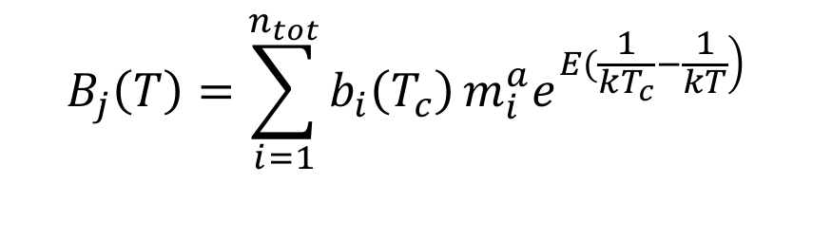
Predicted vs Observed flux
parameter | units | estimate | 95% confidence interval
$$E_{GPP}$$ | eV | 0.741 | 0.196 - 1.286
$$E_{CR}$$ | eV | 1.417 | 0.853 - 1.982
$$α_{GPP}$$ | - | 0.887 | 0.567 - 1.174
$$α_{CR}$$ | - | 1.101 | 0.743 - 1.412
$$\ln{GPP(T_{c})}$$ | µmol O₂ L⁻¹ hr⁻¹ | -3.426 | -6.335 - -0.989
$\ln{CR(T_{c})}$ (ambient mesocosm) | µmol O₂ L⁻¹ hr⁻¹ | -2.717 | -5.943 - -0.150
$\ln{CR(T_{c})}$ (warm mesocosm) | µmol O₂ L⁻¹ hr⁻¹ | -3.110 | -6.126 - -0.650
$$+$$
$$B_{j}\left(T\right)=\sum_{i=1}^{n_{tot}}{b_{i}\left(T_{c}\right)}m_{i}^{a}e^{\left.E(\frac{1}{kT_{c}}−\frac{1}{kT}\right)}$$

Slide 31
Model does a pretty good job!
Observed flux
Observed flux
Predicted flux
Predicted flux

Slide 32
Model does a pretty good job!
Observed flux
Observed flux
Predicted flux
Predicted flux

Slide 33
Paradoxical result?

Slide 34
Zero-sum dynamics
log Total community abundance
Average individual metabolic rate

Slide 35
Zero-sum dynamics
Average individual metabolic rate
Total
abundance
log Total community abundance
Average individual metabolic rate

Slide 36
Conclusions
Linked the metabolic rates of whole communities to the individual size distribution
Flow cytometry routinely taken in scientific ship voyages
As a bonus, validated some key assumptions of metabolic scaling theory

Slide 37
Thanks for listening!

